Slide 1
Hackathon’25 : Solve Rubik’s Cube

Slide 2
Solving 3x3Rubik’s Cube
Aero Hack 2025-Round 3 Submission
N G DILEEP KUMAR

Slide 3
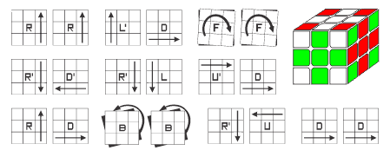
We approach solving the Rubik's Cube as a multi-stage transformation from a scrambled state to a solved state.
The process is broken down into logical steps based on established solving strategies:
🔹 Step-by-Step Breakdown (Beginner Method):
White Cross – Align white edges with center colors.
White Corners – Place white corner pieces correctly.
Middle Layer Edges – Insert the 4 edge pieces of the middle layer.
Yellow Cross – Form a yellow cross on the top.
Position Yellow Corners – Move yellow corners to their correct locations.
Orient Yellow Corners – Twist corners so yellow is on top.
Align Yellow Edges – Complete cube with proper final rotations.
This modularity allows debugging and enhancement of each phase separately.

Slide 4

1. Problem-Solving Approach
1. Breaking Down the Problem
The Rubik’s Cube solution involves a multi-phase process, decomposed into:
Modeling the cube's current state
Performing valid moves that transition it toward a solved state
Detecting when the goal state is reached
The cube can be solved using a layer-by-layer strategy:
Solve white cross
Solve white corners
Solve middle layer edges
Create yellow cross
Position yellow corners
Orient yellow corners
Final alignment of last layer edges
This is known as the Beginner’s Method—easy to implement and debug.
Alternatively, more advanced methods like CFOP, Thistlethwaite, or Kociemba’s can be used for optimal solving but require precomputed tables and deeper heuristics.

Slide 5

Modeling the Cube and Moves
Each face of the cube(U,D,F,B,L,R) has 3x3 facelets. Thus,we can model the cube as a dictionary of 2d arrays:
Python
CopyEdit
Cube={
‘u’:[[‘w’]*3 for_in range(3)], # White
‘D’:[['Y']*3 for _ in range(3)], # Yellow
'F': [['G']*3 for _ in range(3)], # Green
'B': [['B']*3 for _ in range(3)], # Blue
'L': [['O']*3 for _ in range(3)], # Orange
'R': [['R']*3 for _ in range(3)], # Red
}
Each move (e.g., U, R') modifies both the face and adjacent edge pieces. We write a move engine that updates the cube state for each of the 12 base moves.

Slide 6
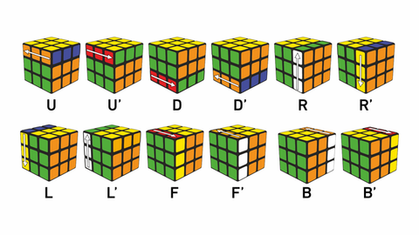
✅ 2. Use of Data Structures
✅ Internal Representation
Option | Used? | Reason
3D Array | ❌ | Adds unnecessary complexity
Dict of 2D Arrays | ✅ | Clear mapping of faces
Graphs / Trees | ❌ | Too heavy for standard solving; used in search-based solvers

Slide 7
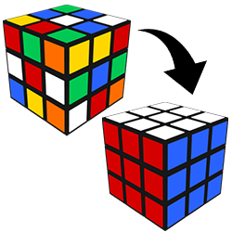
✅ Efficient Structures
Cube State Tracking: Dict of faces for direct access
Move History: Use a list to store sequence of moves
Avoid Revisit (if search-based): Use hashable stringified cube state + set
Example:
Python
CopyEdit
seen_states = set()
state_string = stringify(cube) # function that converts cube state to string
if state_string not in seen_states:
seen_states.add(state_string)

Slide 8
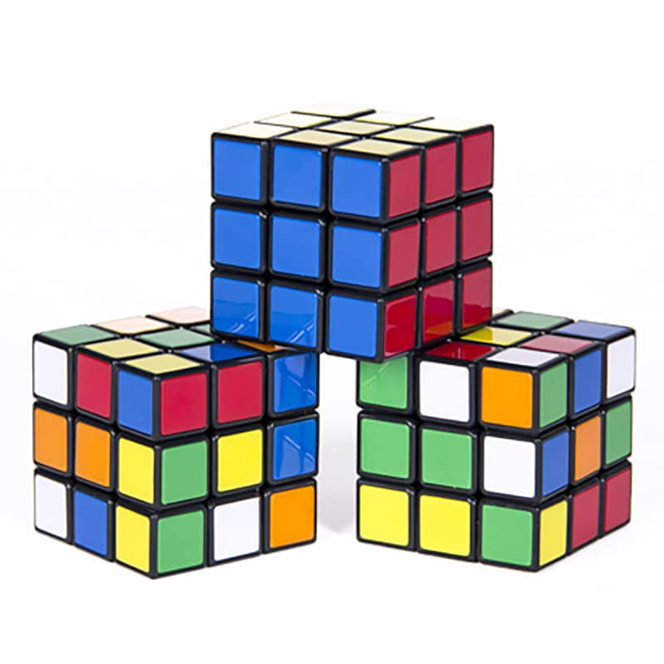
✅ 3. State Prediction Logic
Can it Predict Next State?
Yes. The move engine manipulates both the:
Center face rotation (e.g., rotating face 'R')
Adjacent edges (e.g., edge strips connected to 'R')
Example of a basic move:
python
CopyEdit
def rotate_face_cw(face):
return [list(row) for row in zip(*face[::-1])] # 90° clockwise
The engine updates edge pieces accordingly. Each move is atomic and reversible

Slide 9
Working Algorithm
https://github.com/Dileepkumar-315/3x3x3-Rubbik-s-cube-Solver/upload/main
STEP 1: Cube Representatio
class RubiksCube:
def __init__(self):
# Faces: U, D, F, B, L, R
self.faces = {
'U': [['W'] * 3 for _ in range(3)],
'D': [['Y'] * 3 for _ in range(3)],
'F': [['G'] * 3 for _ in range(3)],
'B': [['B'] * 3 for _ in range(3)],
'L': [['O'] * 3 for _ in range(3)],
'R': [['R'] * 3 for _ in range(3)],
}
def print_cube(self):
for face in ['U', 'D', 'F', 'B', 'L', 'R']:
print(face + ":")
for row in self.faces[face]:
print(" ".join(row))
print()
STEP 2: Face Rotation Utility
def rotate_face_cw(face):
return [list(row) for row in zip(*face[::-1])]
def rotate_face_ccw(face):
return [list(row) for row in zip(*face)][::-1]
STEP 4: Scramble and Solve Example – White Cross
def scramble(cube, moves):
for move in moves:
if move == "R": move_R(cube)
# Add other moves similarly...
def solve_white_cross(cube):
# Dummy implementation for example
print("Solving white cross...")
# Real logic would identify white edge positions and rotate them into place
STEP 3: Implement Move – Example: Right ®
def move_R(cube):
cube.faces['R'] = rotate_face_cw(cube.faces['R'])
U = cube.faces['U']
F = cube.faces['F']
D = cube.faces['D']
B = cube.faces['B']
temp = [U[i][2] for i in range(3)]
for i in range(3):
U[i][2] = F[i][2]
F[i][2] = D[i][2]
D[i][2] = B[2 - i][0]
B[2 - i][0] = temp[i]

Slide 10
STEP 5: Execution if __name__ == "__main__": cube = RubiksCube() scramble_moves = ["R", "R", "R"] scramble(cube, scramble_moves) print("Scrambled cube:") cube.print_cube() solve_white_cross(cube) print("Post white cross (placeholder):") cube.print_cube()
Before Solving (After Scramble)
Scrambled cube:
U: D: F: B: L: R:
W Y G G Y Y G W Y W B G O G G R W Y
W W G W Y Y G G Y W B B O O O R R R
W Y G G Y Y G W Y W B G O G G R W Y
Post white cross (placeholder):
U: D: F: B: L: R:
W W G W Y Y G G Y W B B O O O R R R
W W G W Y Y G G Y W B B O O O R R R
W W G W Y Y G G Y W B B O O O R R R

Slide 11
🔁 Abstraction of Moves
Each move (U, U', R, R', etc.) is represented as a function or object. They can be:
1.Chained: ["U", "R", "U'"]
2.Reversed: reversed_move("U") -> "U'"
✅ 4. Algorithm Efficiency
🕒 Speed & Complexity
Metric | Beginner Method | Advanced (e.g., IDA*)
Time Complexity | ~O(1) steps per layer | Depends on depth (IDA*)
Space Complexity | O(1) for cube + moves list | High for heuristic tables
Beginner method is not optimal but fast and predictable.
Kociemba/IDA* gives shorter solutions but needs more memory and precomputing.

Slide 12
📏 Move Optimality
Beginner’s Method: ~100–150 moves
Optimal Solver (Kociemba): ~20 moves (God’s Number ≤ 20)
✅ Conclusion
Area | Implementation Notes
Problem Decomposition | Layer-by-layer (Beginner method)
Data Structures | dict of 2D arrays, list for history
Prediction Logic | Robust move engine with chaining
Efficiency | Fast for solving, scalable to 4x4+ if modularized

